Slide 1
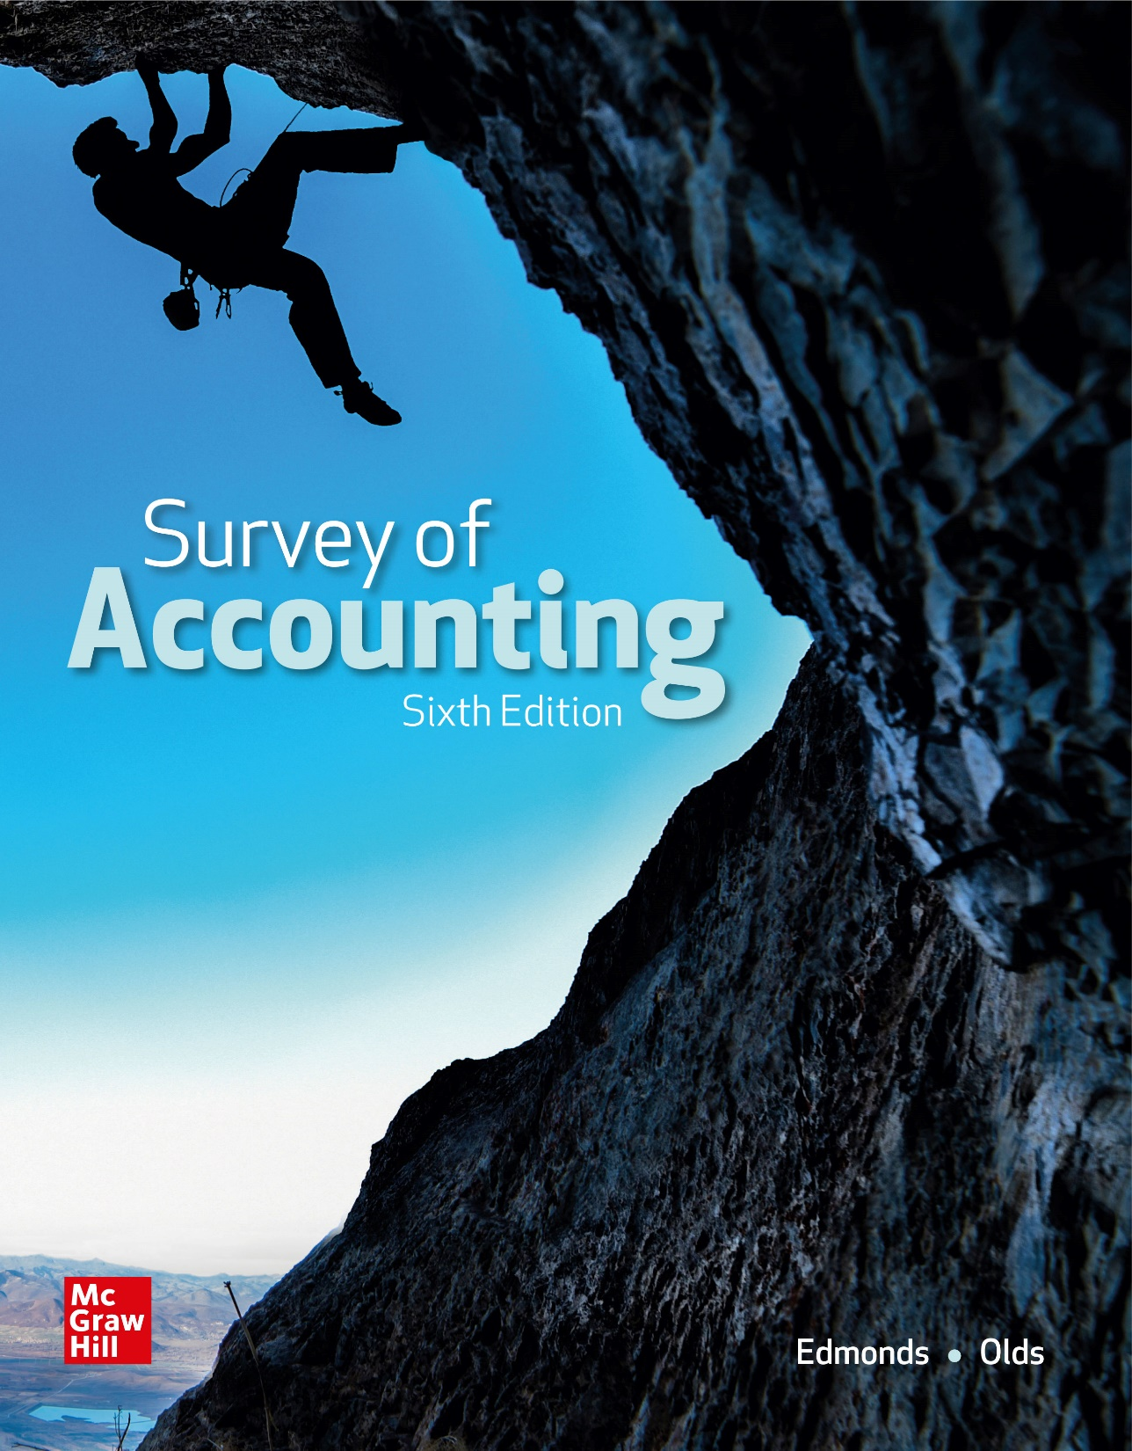
Chapter 10
An Introduction to Management Accounting

Slide 2
LO 10-1:
Distinguish between managerial and financial accounting.

Slide 3
Differences Between Managerial and Financial Accounting
Financial accounting provides information primarily for users outside a business while managerial accounting focuses in information for those who work inside a business.
External users generally desire information about the performance of a company as a whole while internal users focus on detailed information about specific subunits.
Financial accounting is designed to generate information for the general public.

Slide 4
Differences Between Managerial and Financial Accounting
Financial accounting is characterized by its objectivity, reliability, consistency, and historical nature while managerial accounting is more concerned with relevance and timeliness.
Financial accounting information is reported periodically, normally at the end of a year. Management cannot wait until the end of the year to discover problems.

Slide 5
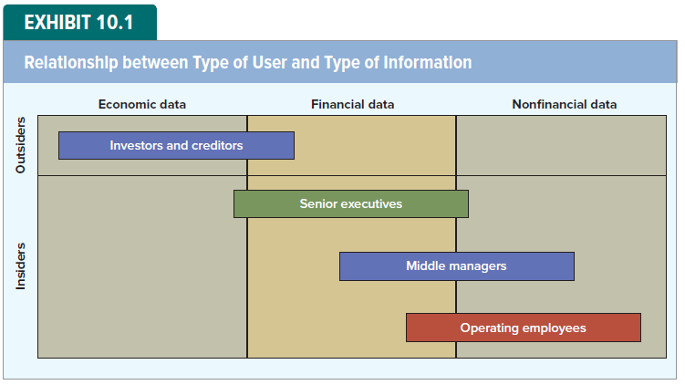
Type of User versus Type of Information

Slide 6
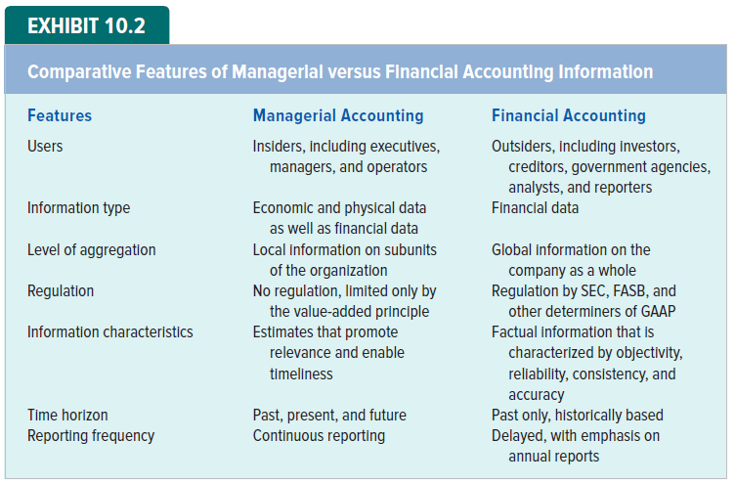
Managerial versus Financial Accounting

Slide 7
LO 10-2:
Identify the cost of manufacturing a product.

Slide 8
Components of Product Cost
Generally accepted accounting principles (GAAP) recognize three types of costs that are incurred in the process of making products:
The materials used to make the products (direct raw materials)
The labor used to transform the materials into products (direct labor), and
The overhead (other indirect costs such as utilities consumed in the process of making the products).

Slide 9
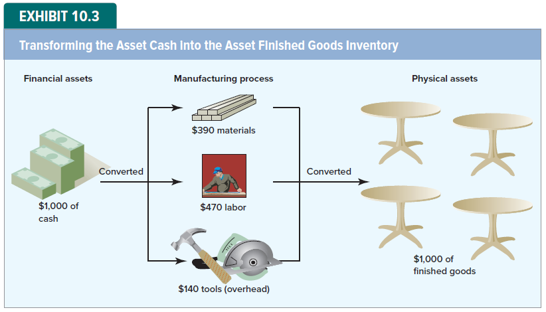
Product Costing in Manufacturing Companies

Slide 10
Average Cost per Unit
How much did each table cost?
The actual cost of each of the four tables likely differs.
Accountants therefore normally calculate cost per unit as an average.
In the case of Tabor Manufacturing, the average cost per table is $250 ($1,000 ÷ 4 units).

Slide 11
Costs Can Be Assets or Expenses
Product Cost
Asset
COGS
Period Cost
Expense

Slide 12
Costs Can Be Assets or Expenses
All product costs (materials, labor, and overhead) remain in an inventory account until revenue is earned when the inventory is sold.
Costs that are not classified as product costs are normally expensed in the period in which they are incurred.
They include general, selling and administrative costs, interest costs, and the cost of income taxes.

Slide 13
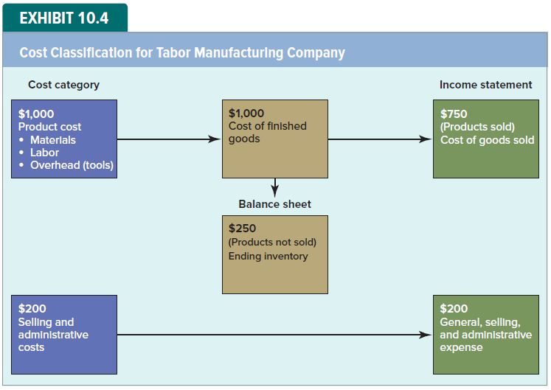
Cost Classification

Slide 14
LO 10-3:
Show how manufacturing product costs affect financial statements.

Slide 15
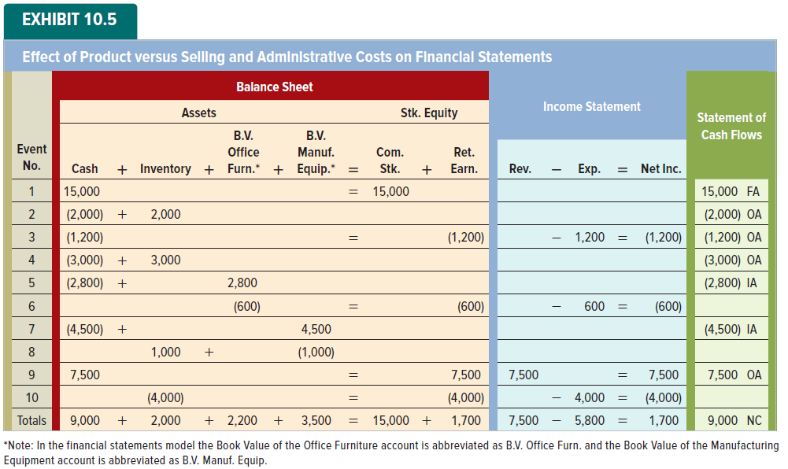
Effect of Costs on Financial Statements

Slide 16
Materials Costs (Event 2)
Materials used to make products are usually called raw materials.
The cost of raw materials is first recorded in an asset account (Inventory).
The cost is then transferred from the Inventory account to the Cost of Goods Sold account at the time the goods are sold.
Materials cost is only one component of total manufacturing costs.

Slide 17
Labor Costs (Event 4)
The salaries paid to selling and administrative employees (Event 3) and the wags paid to production workers (Event 4) are accounted for differently.
Salaries paid to selling and administrative employees are expensed immediately.
Production wages are added to inventory and expensed as part of cost of goods sold at the time the inventory is sold.

Slide 18
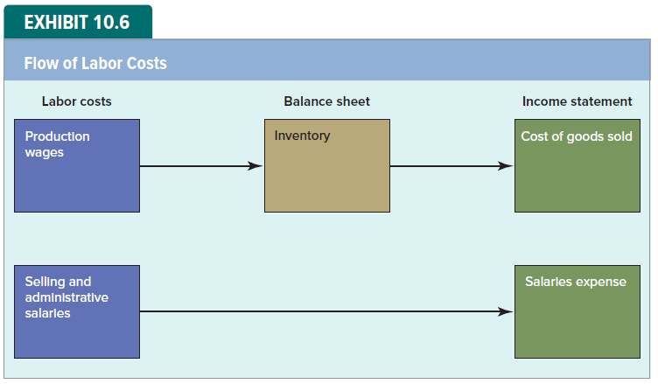
Flow of Labor Costs

Slide 19
Overhead Costs (Event 8)
Depreciation was $600 on office furniture and $1,000 on manufacturing equipment.
Only the $600 of depreciation on the office equipment is expense directly.
The depreciation on the manufacturing equipment is split between the income statement (cost of goods sold) and the balance sheet (inventory).

Slide 20

Flow of Depreciation Costs

Slide 21
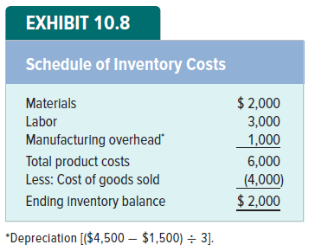
Total Product Cost

Slide 22
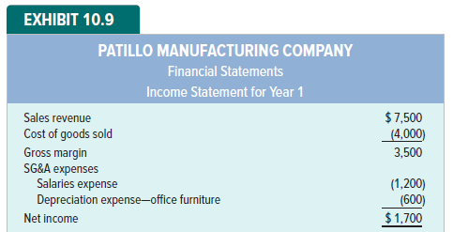
Income Statement for Year 1

Slide 23
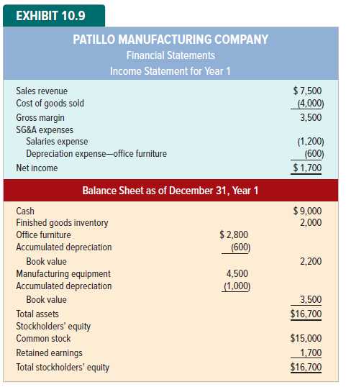
Balance Sheet as of December 31, Year 1

Slide 24
Overhead Costs: A Closer Look
Costs that cannot be traced to products and services in a cost-effective manner are called indirect costs.
The indirect costs incurred to make products are called manufacturing overhead.
Some of the items commonly included are indirect materials, indirect labor, factory utilities, rent of manufacturing facilities, and depreciation on manufacturing assets.

Slide 25
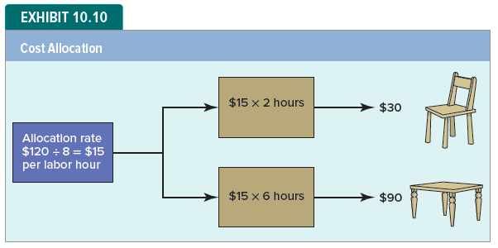
Indirect Cost Allocation

Slide 26
Manufacturing Product Cost Summary
The cost of a product made by a manufacturing company is normally composed of three categories:
Direct materials,
Direct labor, and
Manufacturing overhead.
Relevant information about these three cost components is summarized in the next two slides.

Slide 27
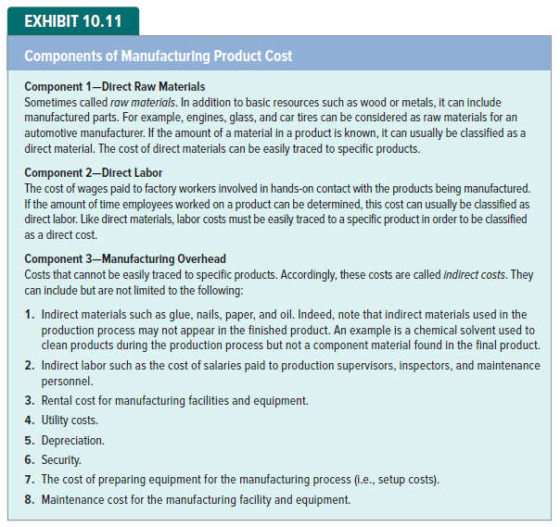
Components of Manufacturing Product Cost

Slide 28
Components of Manufacturing Product Cost

Slide 29
LO 10-4:
Compare the treatment of upstream, midstream, and downstream costs in manufacturing, service, and merchandising companies.

Slide 30
Cost Classification in Manufacturing Companies
For manufacturing companies:
Midstream costs are composed of the costs incurred in the process of making products.
Upstream costs are incurred prior to the manufacturing process.
Downstream costs are costs incurred after the manufacturing process.

Slide 31
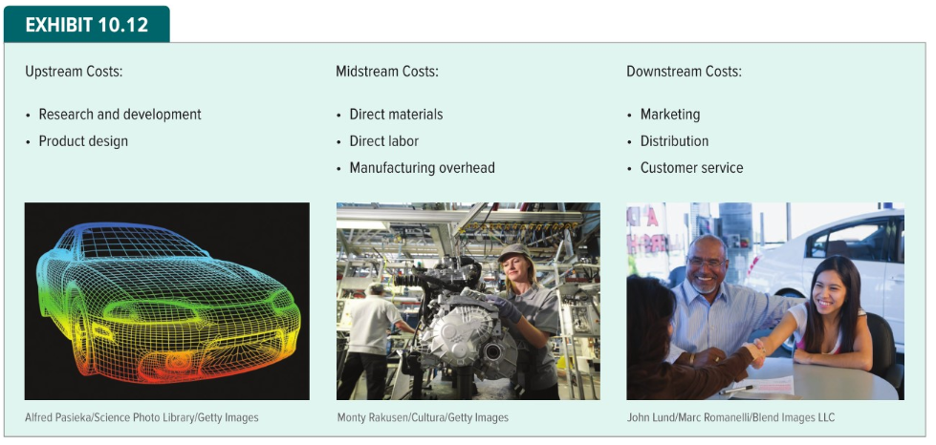
Upstream Costs

Slide 32
Midstream Costs

Slide 33
Downstream Costs

Slide 34
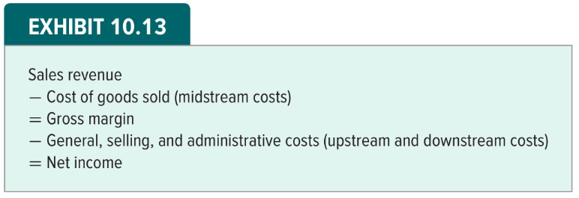
GAAP-Based Income Statement

Slide 35
Service, Merchandising and Manufacturing Companies
Companies are frequently classified as being service, merchandising, or manufacturing businesses.
Service organizations provide services to customers.
Merchandising businesses buy goods that are sold to customers or other companies.
Manufacturing companies make the goods they sell to their customers.

Slide 36
Cost Classification in Service and Merchandising Companies
Service and merchandising companies incur materials, labor and overhead costs.
The primary difference between manufacturing entities and service companies is that the finished products provided by service companies are consumer immediately.
Merchandising companies do not make the products they sell.

Slide 37
LO 10-5:
Prepare a schedule of cost of goods manufactured and sold.

Slide 38
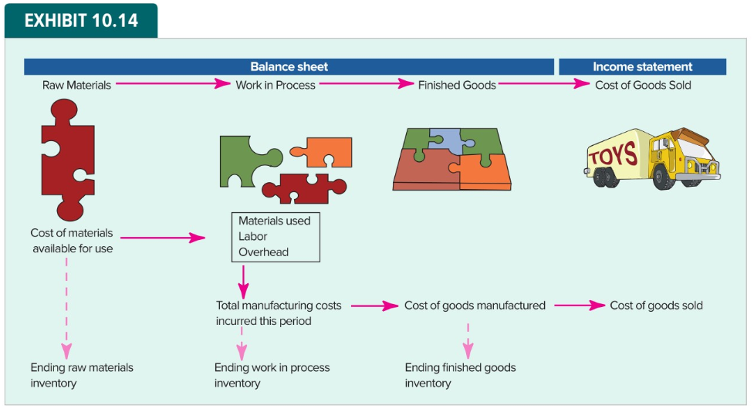
The Flow of Manufacturing Costs through the Accounting Records

Slide 39
Year 2 Activity for Patillo Manufacturing
During year 2, Patillo Manufacturing:
Purchased $37,950 of raw materials and used $37,000 of raw materials
Incurred $34,600 of labor costs
Incurred $26,700 of overhead costs
Completed work on products that cost $94,600
Beginning balance for Year 2 for finished goods is $2,000

Slide 40
Year 2 Balances for Patillo Manufacturing
During Year 2 Patillo had sales revenue of $153,000
The Year 2 ending balances for the inventory accounts were as follows:
Raw Materials Inventory, $950
Work in Process Inventory, $3,700
Finished Goods Inventory, $3,200

Slide 41
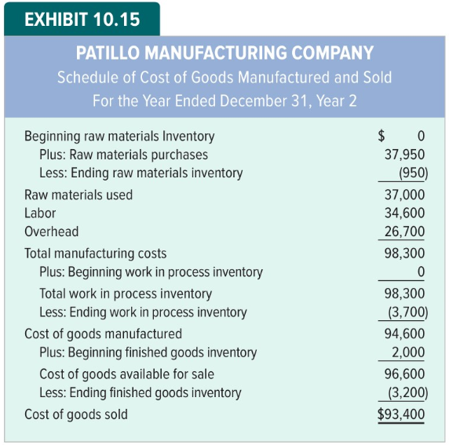
Schedule of Cost of Goods Manufactured and Sold

Slide 42
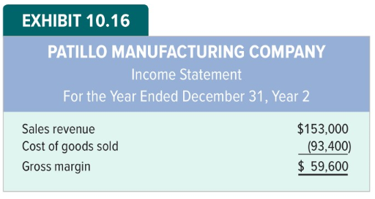
Partial Income Statement

Slide 43
LO 10-6:
Show how just-in-time inventory can increase profitability.

Slide 44
Just-in-Time Inventory
Companies attempt to minimize the amount of inventory they maintain because of the high cost of holding it.
Many businesses have been able to simultaneously reduce their inventory holding costs and increase customer satisfaction by making products available just in time (JIT) for customer consumption.

Slide 45
Holding Costs
Obvious holding costs
Financing, warehouse space, supervision, theft, damage and obsolescence.
Hidden holding costs
Diminished motivation, sloppy work, inattentive attitudes and increased production time.

Slide 46
Benefits of Just-in-Time Inventory
Paula Elliott supports herself by selling flowers.
She reengineered her distribution system by purchasing her flowers from a florist within walking distance of her sales location.
JIT provided:
Elimination of nonvalue-added activity of driving to the former florist.
Avoidance of lost opportunities by not turning away prospective customers.

Slide 47
LO 10-7:
Identify the standards contained in IMA’s Statement of Ethical Professional Practice.

Slide 48
Difficult Choices and Decisions to Manipulate Reports
Management accountants can face pressure to:
Undertake duties they have not been trained to perform competently.
Disclose confidential information.
Compromise their integrity through falsification, embezzlement, bribery, and so on.
Issue biased, misleading, or incomplete reports.

Slide 49
Ethical Considerations
Certified Management Accountants are guided by the IMA Statement of Ethical Professional Practice
The statement provides standards on
Competence
Confidentiality
Integrity
Credibility
Resolution of ethical conflict

Slide 50

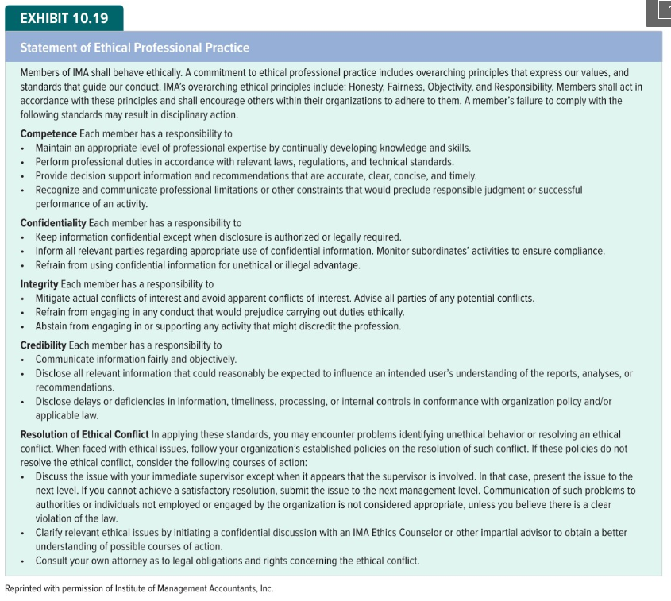
IMA Statement of Ethical Professional Practice

Slide 51

IMA Statement of Ethical Professional Practice

Slide 52
End of Chapter 10

